Slide 1

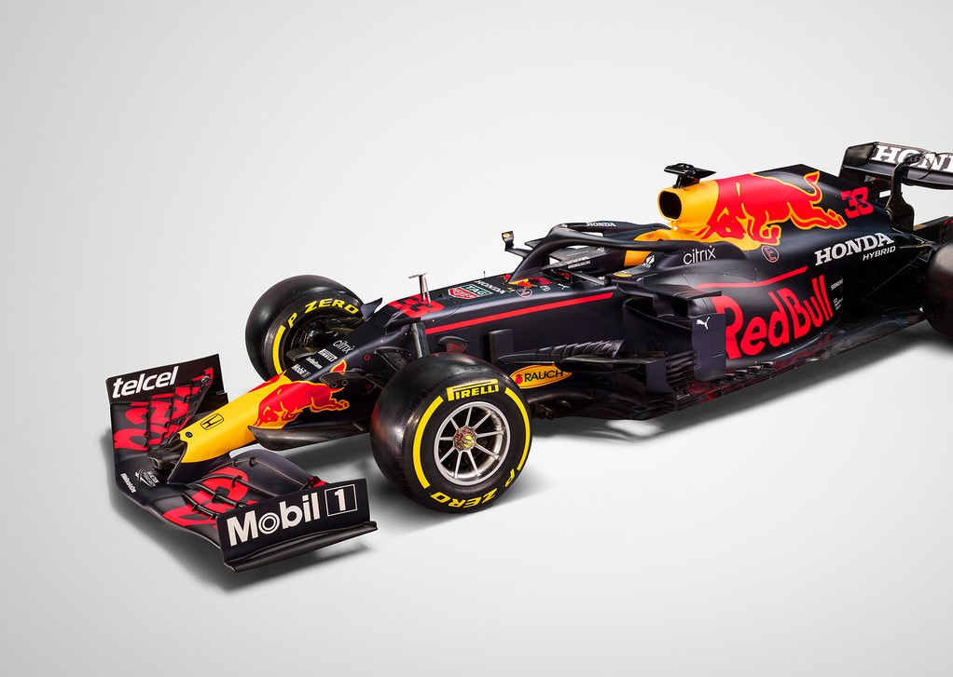
Van Bellinghen Brandon

Slide 2





944 stables in Formula One
this represents the top 5
Constructor Standings won

Slide 3
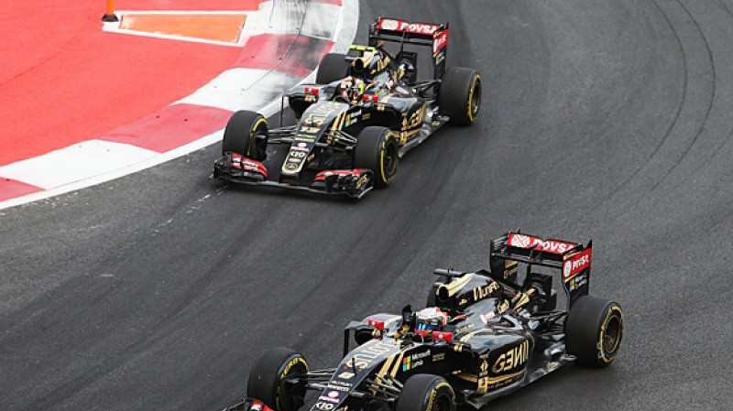


the three lives of Lotus

Slide 4
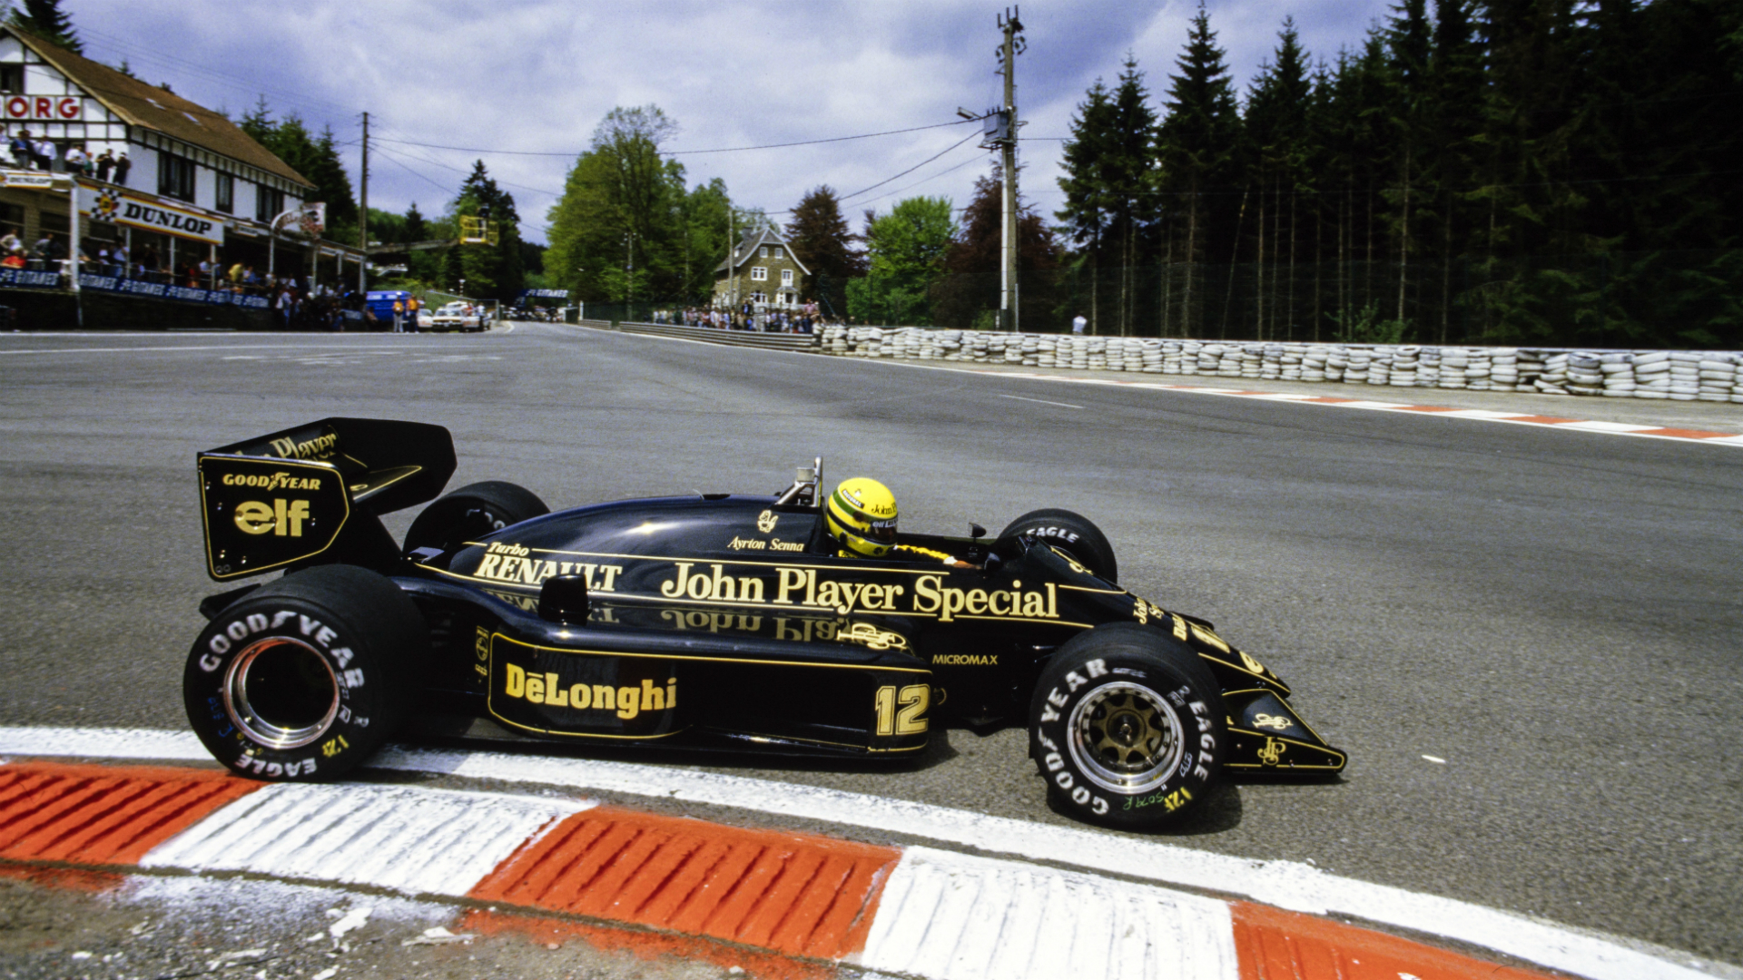
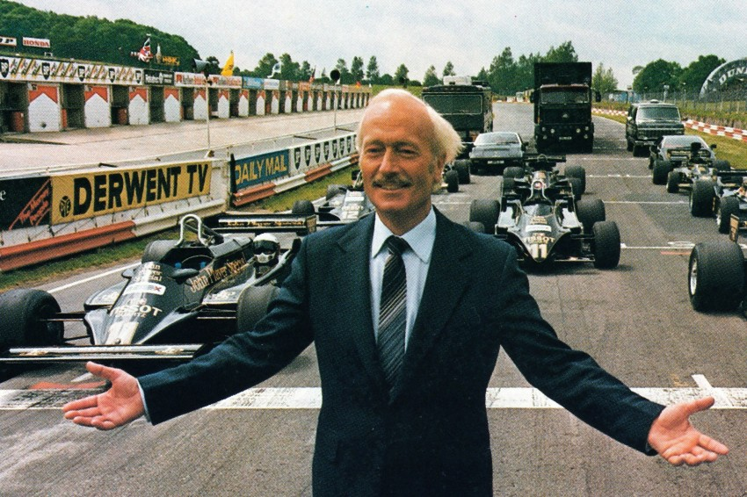
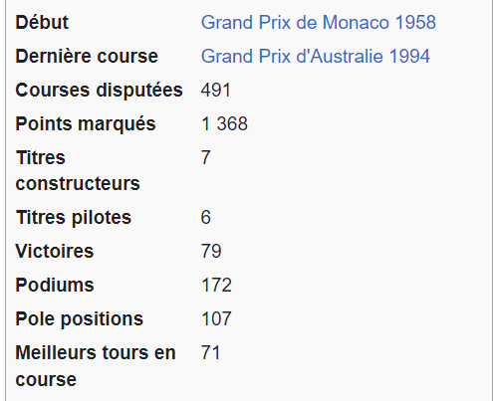
The First Life of Lotus from 1958 to 1994
Colin Chapman
Source: Wikipedia
team manager of Lotus

Slide 5
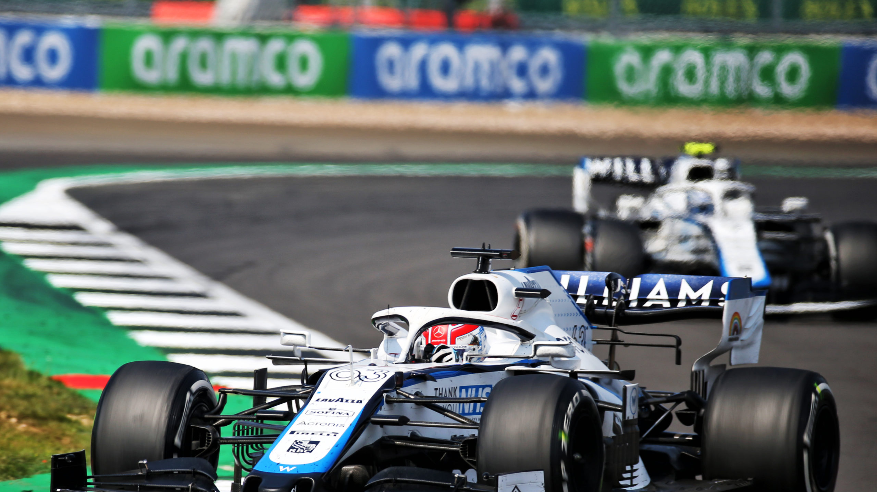
Williams
Racing

Slide 6
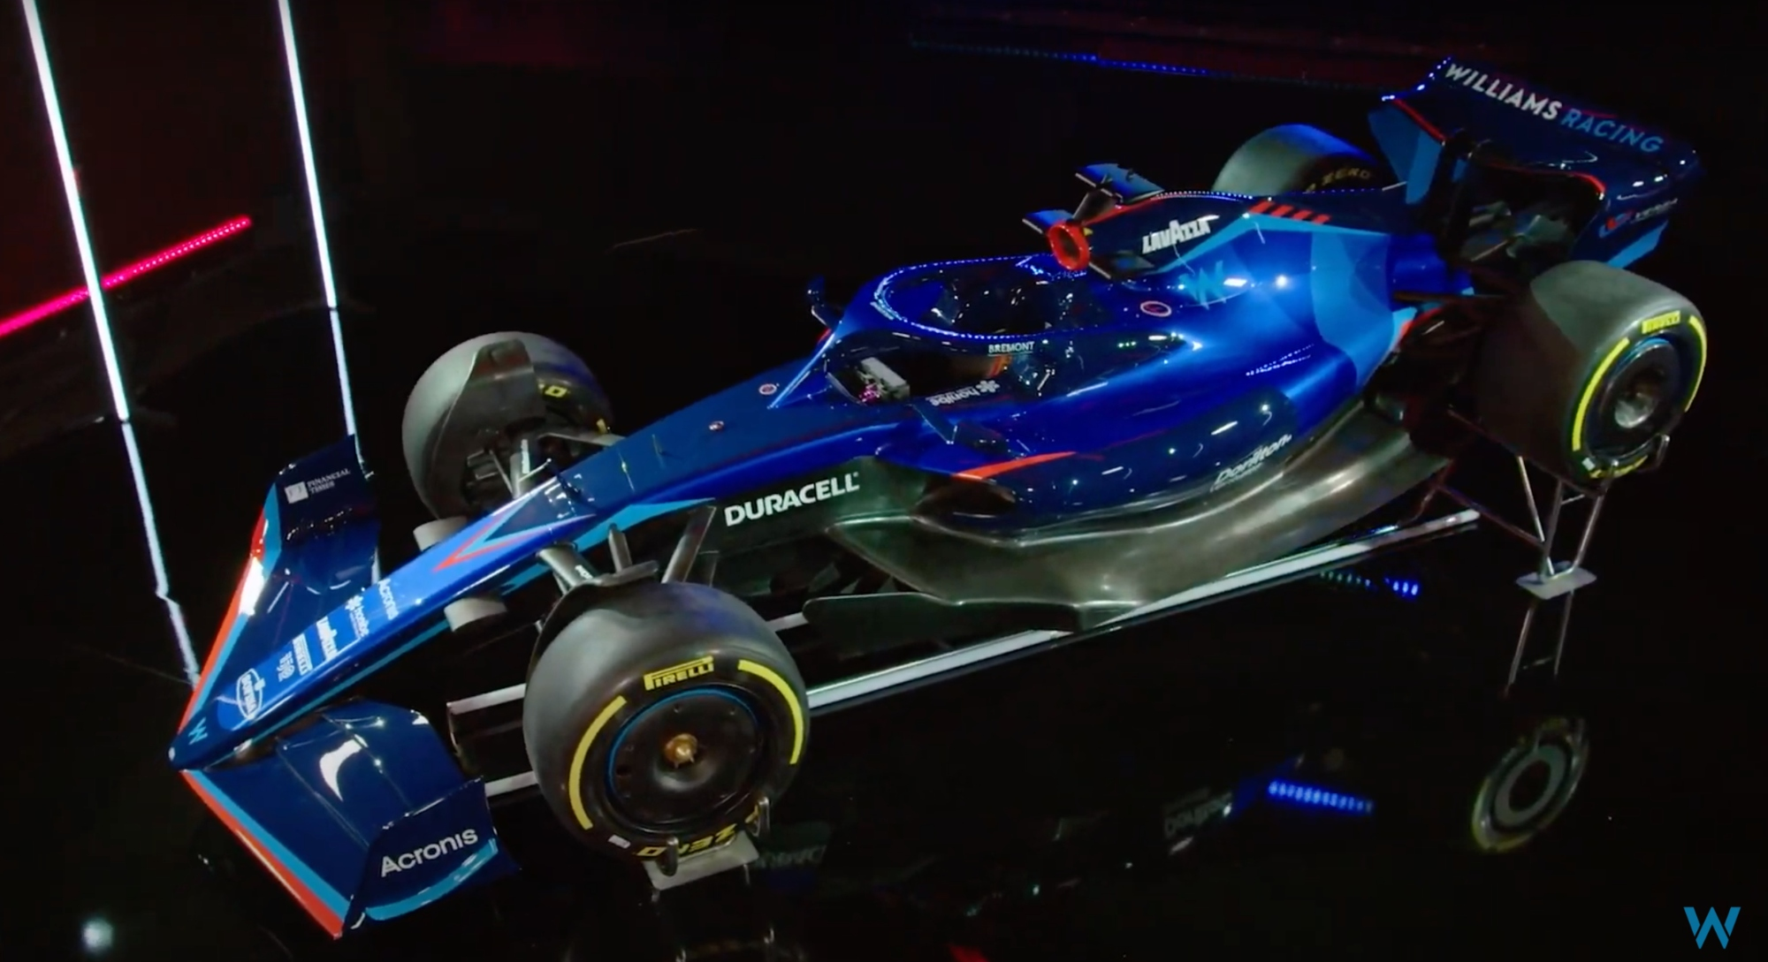
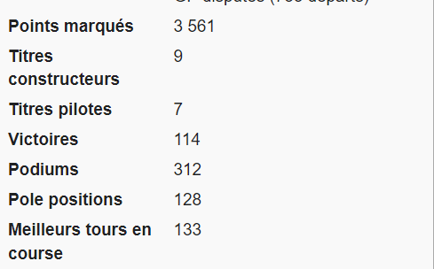
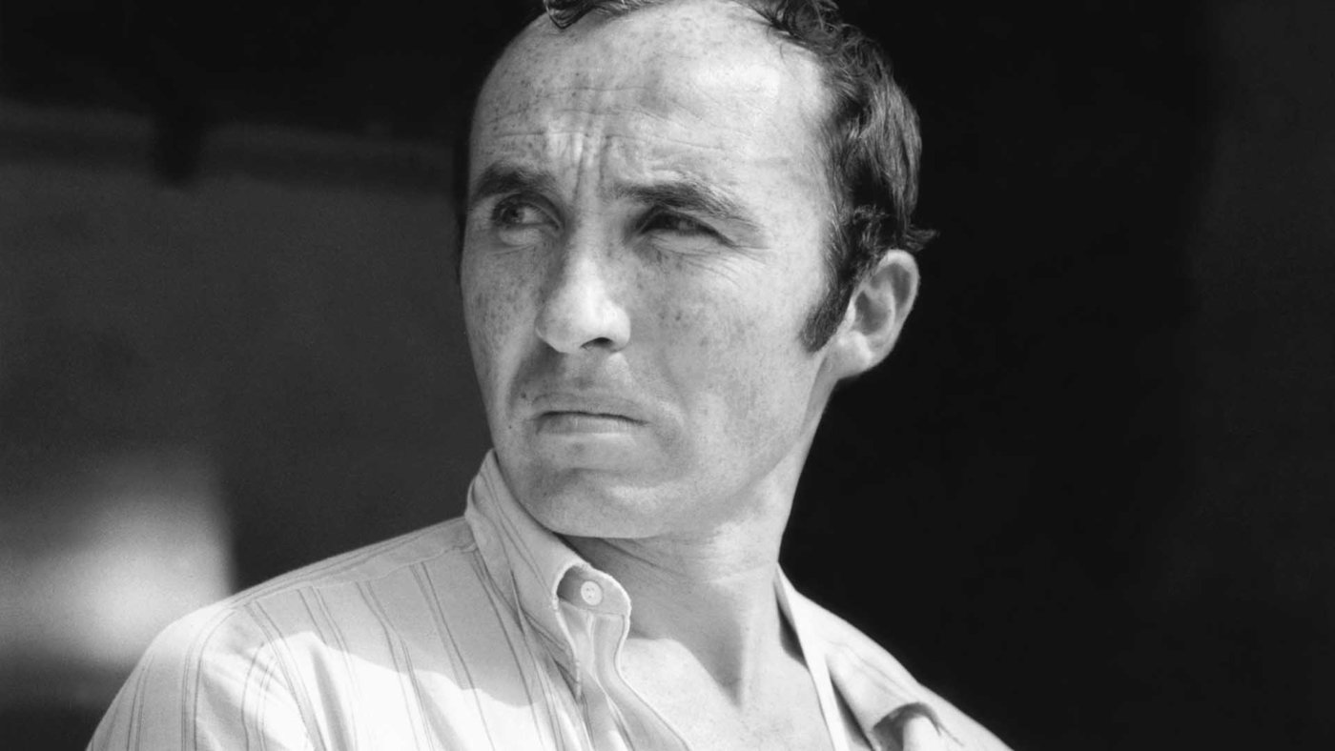
Williams has been around since 1977
Frank Williams
The Williams’ Creator
Source: Wikipedia

Slide 7
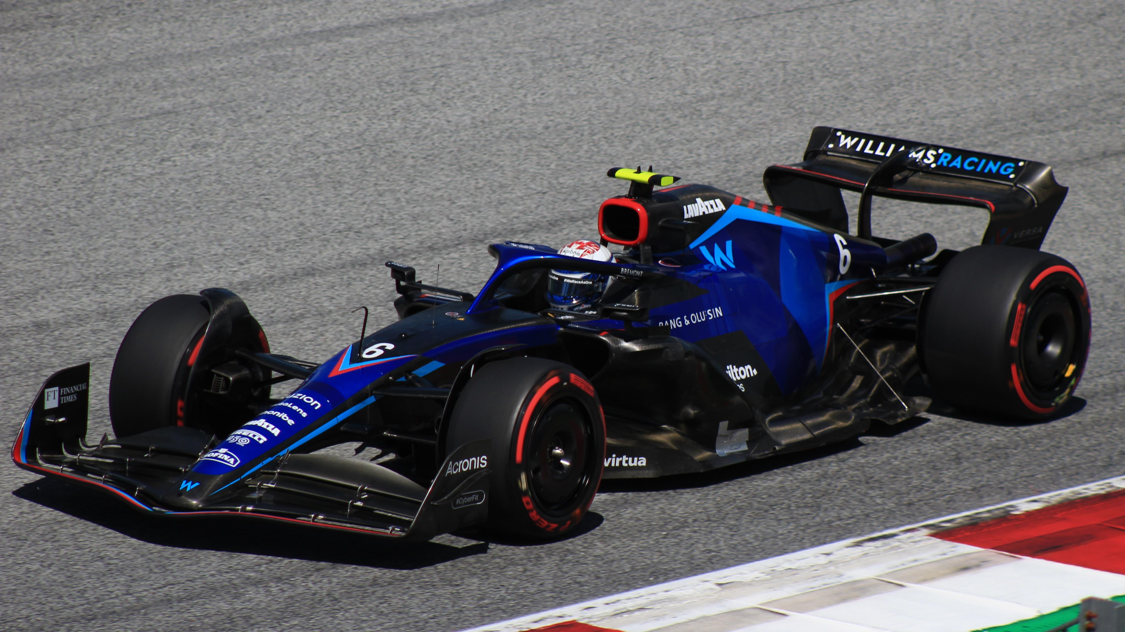
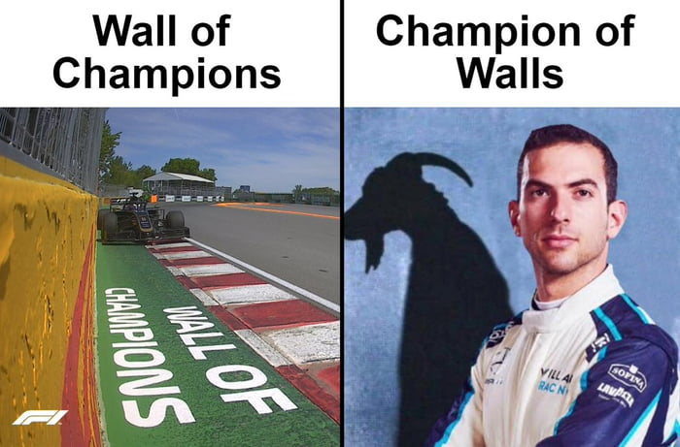

The Williams Current

Slide 8
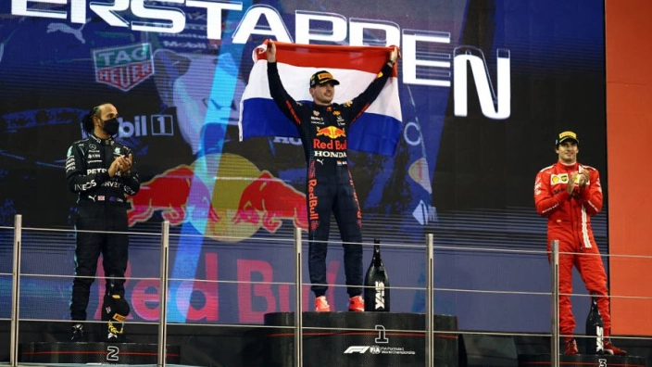
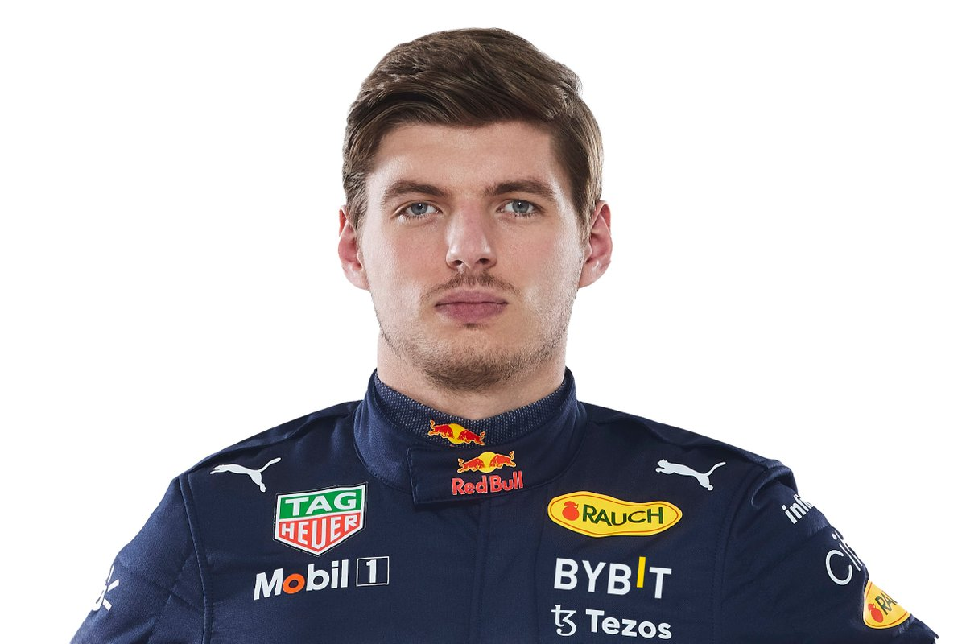

34 world champion
in History
World Champion 2022
since Sunday
Since 1950

Slide 9
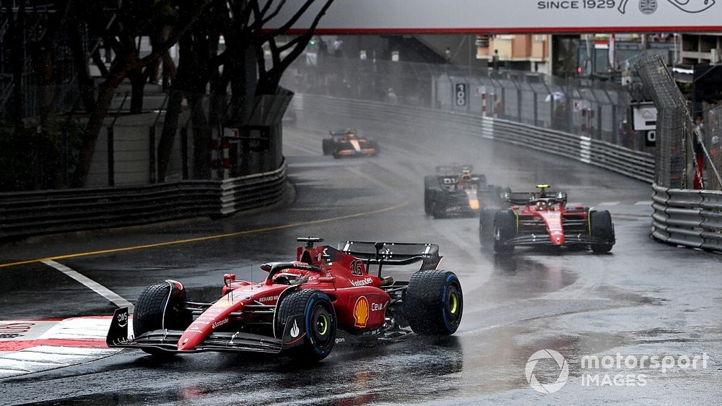
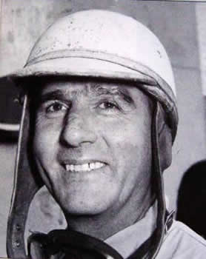
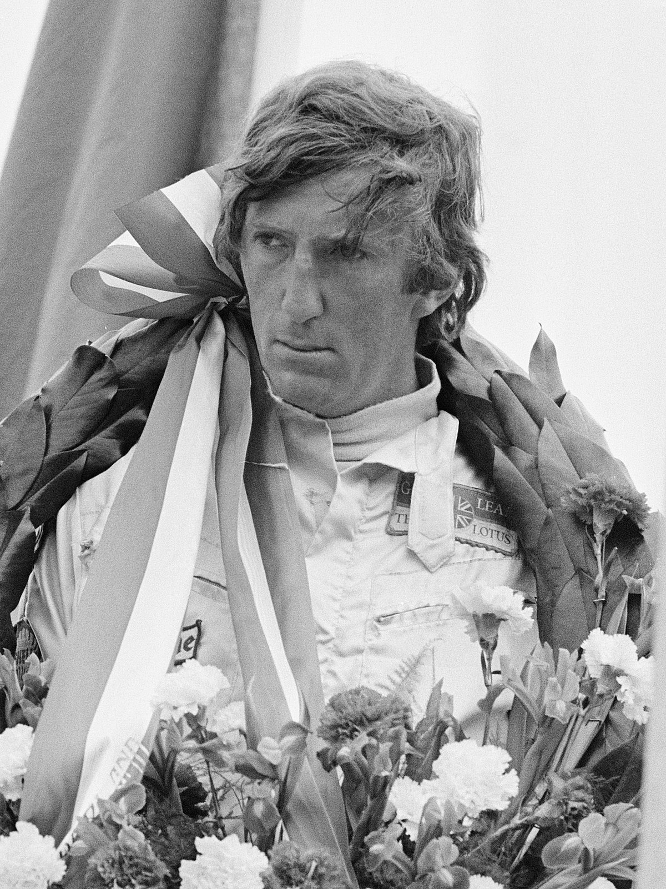
The First
Champion
posthumous
world champion

Slide 10
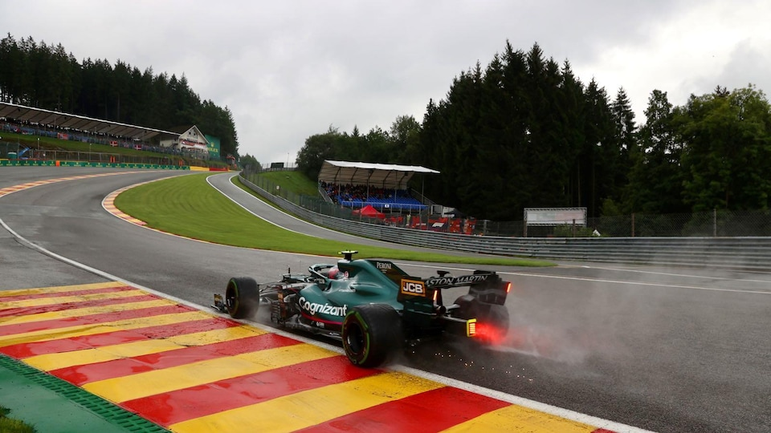
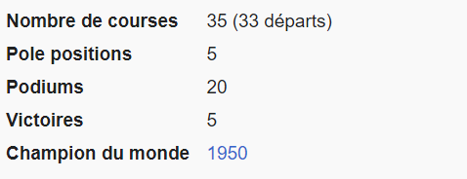
The First Winner in F1
The First World Champions
ran from 1950 to 1956
drove for 2 teams
Guiseppe
Farina
‘’ Nino Farina ‘’
Source: Wikipedia

Slide 11
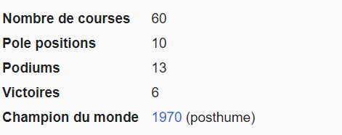
the only posthumous champion
Died at 28 at Italian Grand Prix
ran from 1964 to 1970
drove for 4 teams
Jochen
Rindt
Source: Wikipedia

Slide 12
The Question Time

